Slide 1
2021 NER Scholarship winners

Slide 2
NER WOCN Scholarship Committee 2021
Emilee Bartolo – Committee Chair
Angela Ryan
Donna Truland
Janet Mantel
Jaylynn Fisher
Lia Van Rijswijk
Vashti Livingston
Julie Rivera

Slide 3
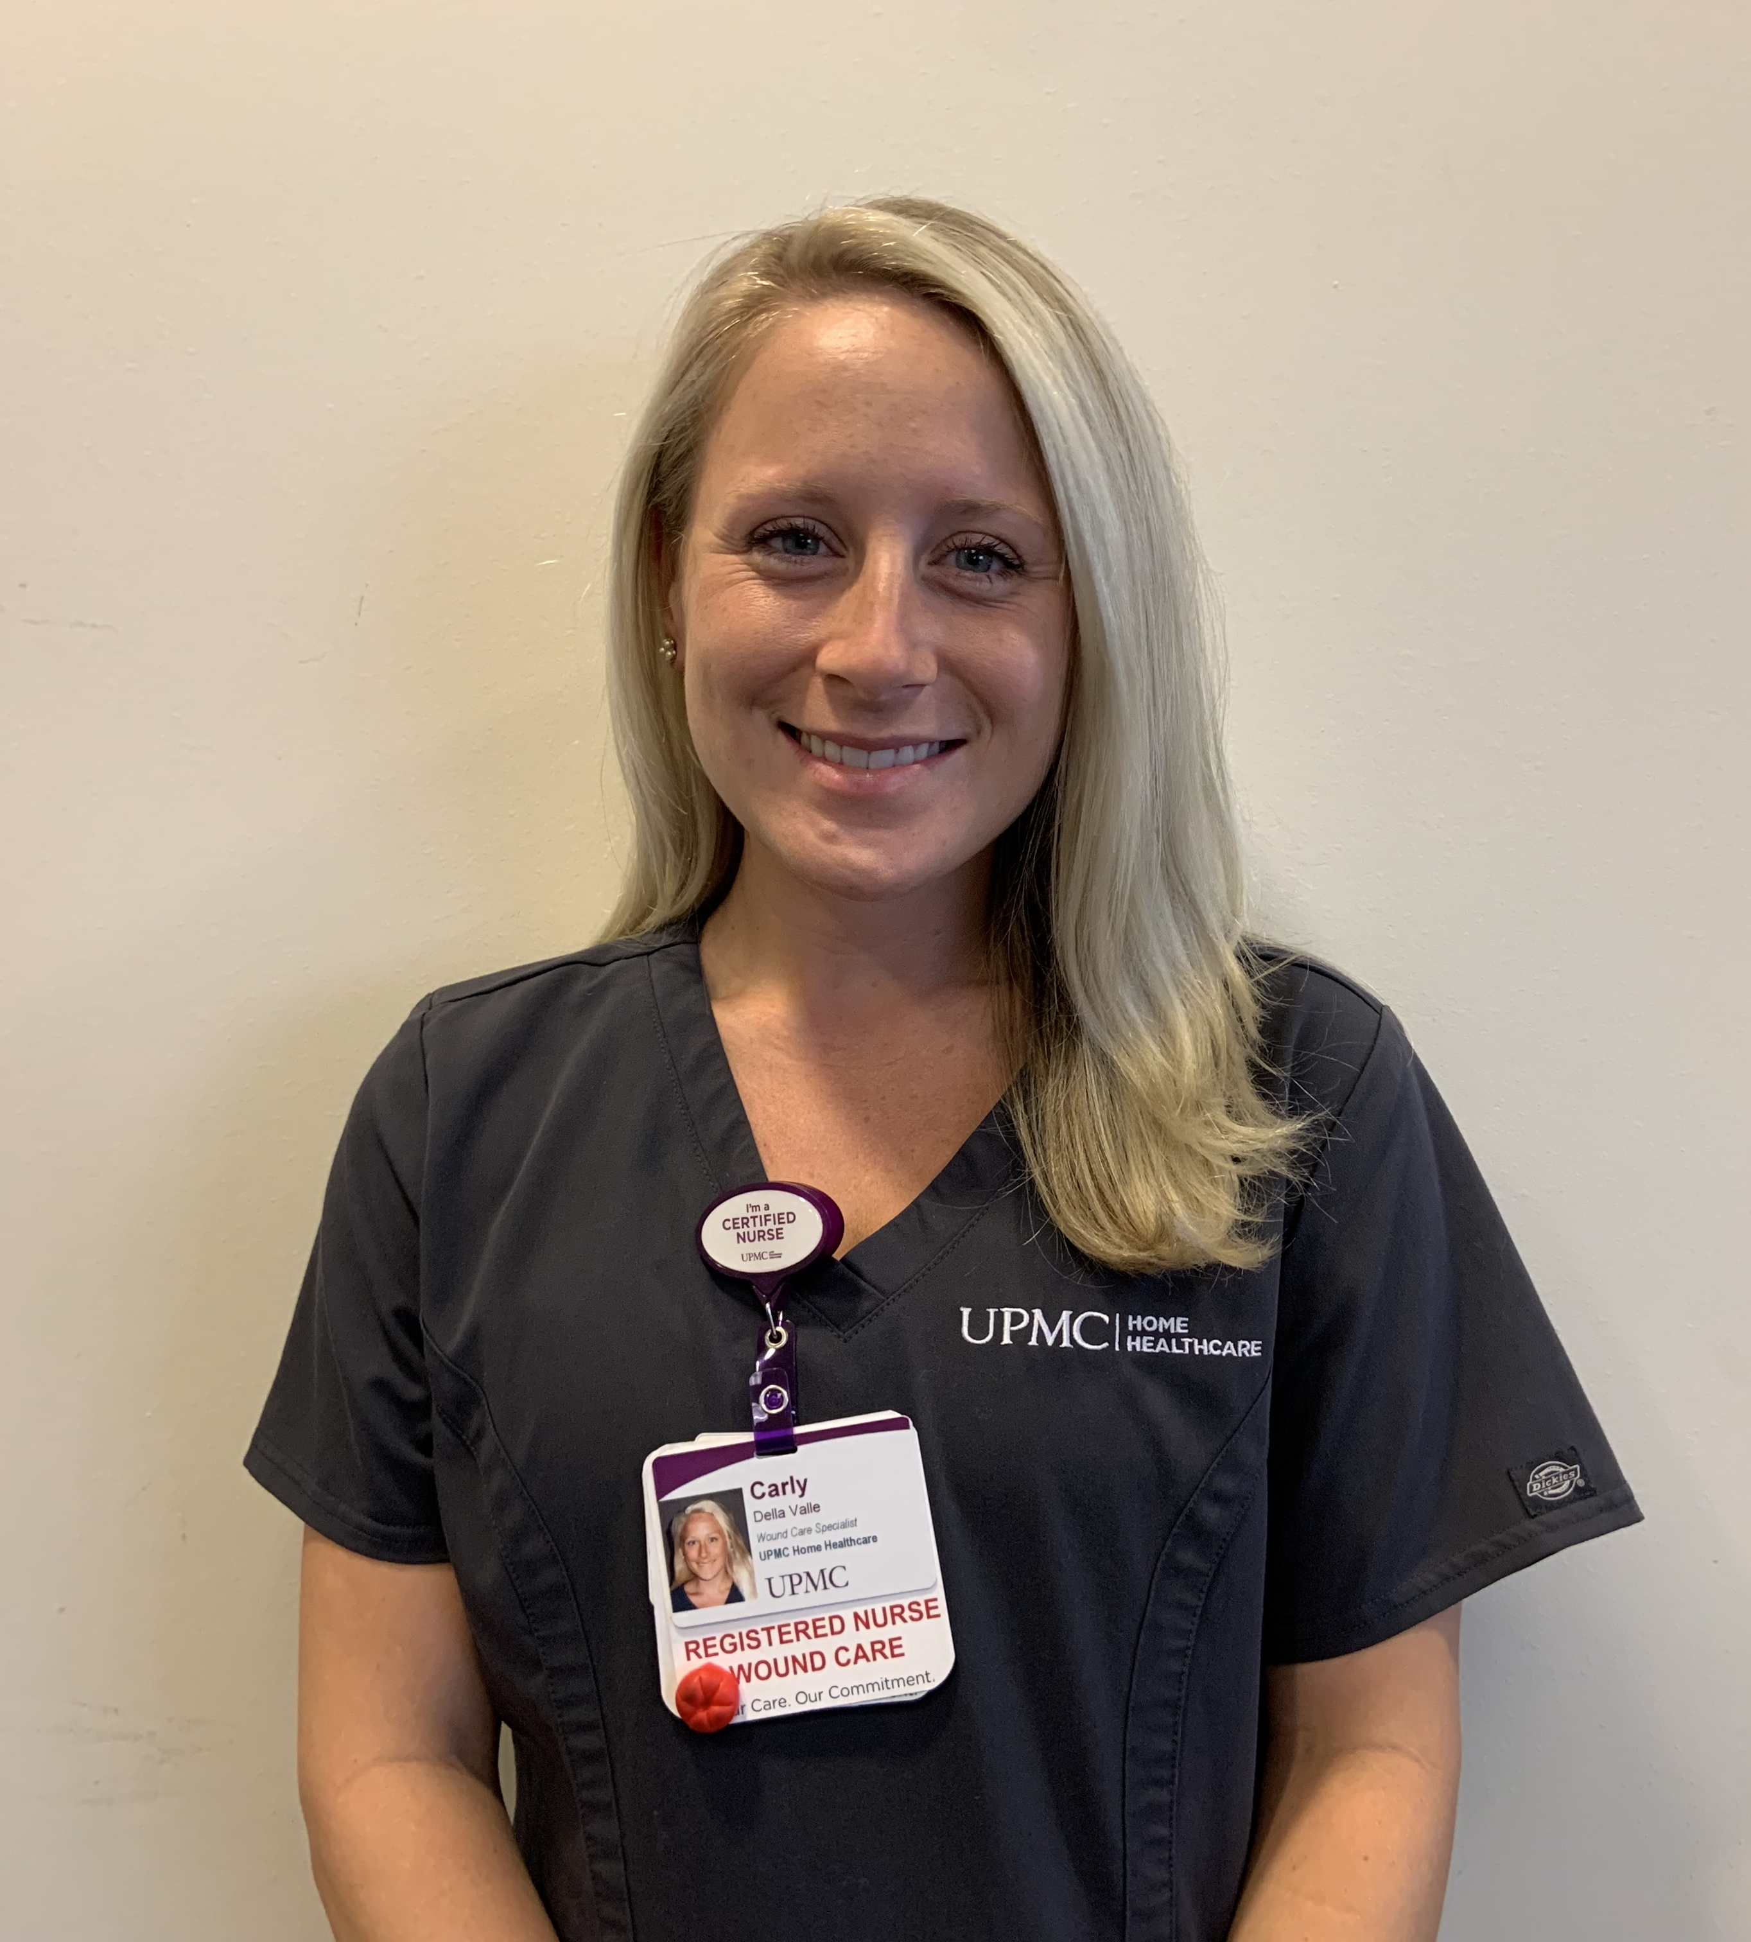
Carly della valle, wocnep
Recently I started as a Wound Care Specialist with UPMC Home Healthcare, and I quicky felt the urge to become a WOCN. By attending the Cleveland Clinic WOCN program, I hope to pass along knowledge to clinical staff as well as patients and uphold high quality patient care. I have been an active member on the Wound Treatment Associate (WTA) Evidence Base Practice Committee since September of 2019. In addition, I have furthered my nursing knowledge by obtaining my MSN in Clinical Leadership from Robert Morris University.
Being granted this scholarship would help to ensure financial stability while continuing my education. Having a 1-year-old, with another baby on the way, being financially stable is of high priority. By obtaining the WOCN now, I hope to build a solid foundation early in my career to continue to learn and be a positive influence in the field of wound, ostomy, and continence care. I am very enthusiastic for this opportunity to advance my career and I appreciate your consideration in me for receiving a scholarship through the NER affiliate.

Slide 4
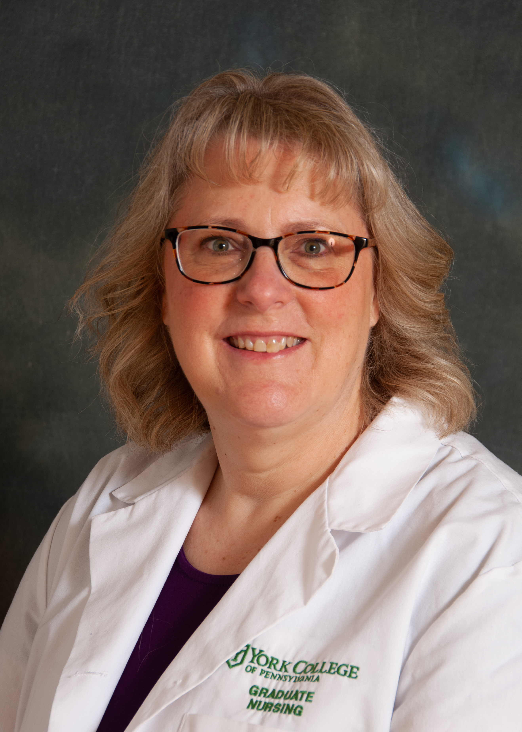
Beth myers, advanced

Slide 5
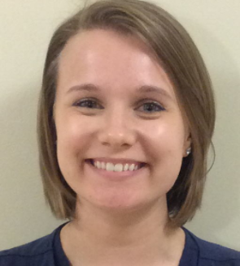
Alexis haar, WOCNEP
In obtaining my WOCN I hope to build a foundation of knowledge to improve my critical thinking and hands on skills. In September 2020, I had the opportunity flex to a full-time wound position in which I can do both inpatient and outpatient wound care in York, Pennsylvania. My hope is that my certification will allow me to be more flexible and support my team.
Over this past year, we have seen overloaded censuses in our hospitals and many critically ill patients due to the Covid-19 pandemic. These patients require more nurses who have a wealth of knowledge and experience in wound healing and prevention. One of my passions is education, not only for my patients, but also for staff. A few years ago, I developed an ostomy tip sheet for the nurses on our unit, as I noted many nurses have difficulty changing ostomy devices and providing ostomy care. In teaching staff throughout the system to implement pressure injury prevention measures and wound care techniques, we are able to reduce our workload, improve patient outcomes, and decrease the overall cost of healthcare.

Slide 6
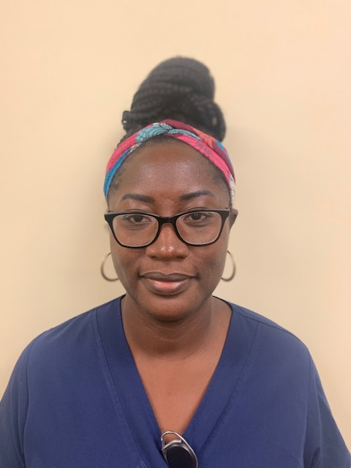
Nadege st. hubert, WOCNEP

Slide 7
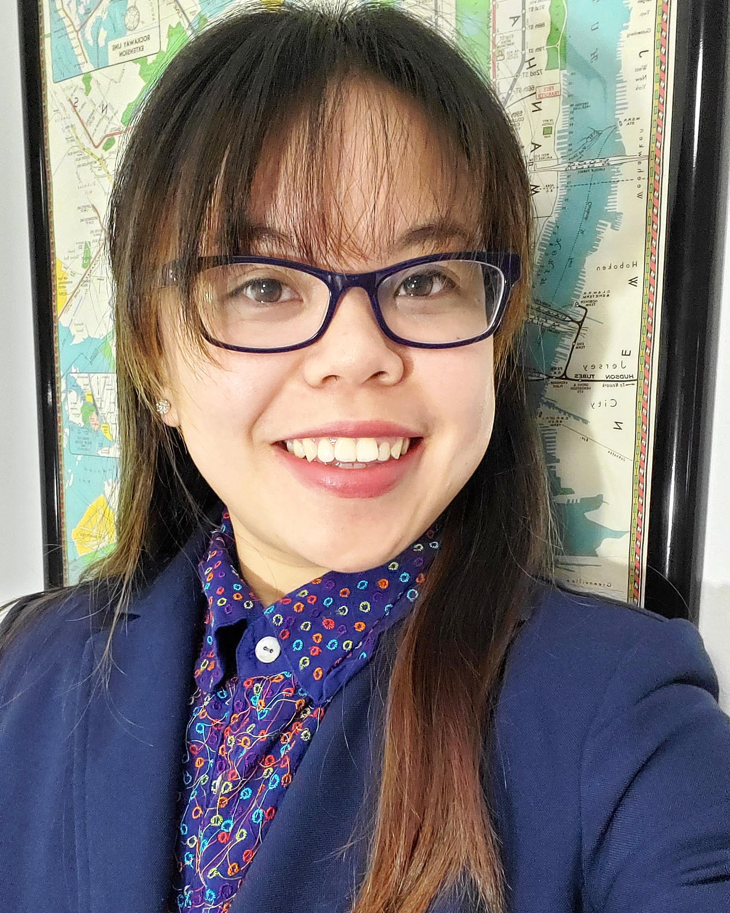
Sharon ng, WOCNEP

Slide 8
Congratulations to the 2021 NER scholarship recipients!!!

